Slide 1
Creative training to develop knowledge and skills
LTT C3,
Varna Bulgaria ,
27.07 – 31.08.2021
Project number: 2019-1-IT02-KA204-062395

Slide 2
List as many items as possible that:
are red
are cold
SMALL
ENERGIZER
are sour
are the size of a clenched fist
are used to move
are used to warm the body

Slide 3
The art of creative thinking is that special quality of the mind, that allows us to unravel seemingly unsolvable problems and create surprising novelty.
The joy of creative thinking:
stimulation of fluency,
flexibility and originality of thinking;
practice thinking with questions;
creative linking - working on combination thinking;
applying transformational thinking;
methodology of creativity training.

Slide 4
Six principles that facilitate creative thinking (E. Nęcka)
The principle of diversity
The principle of deferred evaluation
The principle of rational irrationality
The principle of competent incompetence
The principle of fun
The principle of validity

Slide 5
Six principles that facilitate creative thinking
The principle of diversity means that you should always look for as many solutions as possible, regardless of their quality. The more the better"
The principle of deferred evaluation is refraining from judging, which is one of the most important obstacles to creative thinking.
The principle of rational irrationality is based on the skilful use of emotions and intuition in the phase of coming up with a solution, reason becomes useful only at the moment of judging.
The principle of competent incompetence means that anyone can solve a problem, even in a field in which they do not know, as long as they can count on the help of an expert.
The principle of fun. If the task is to be fun, it can't be boring. If the task is interesting, it is easier to find a solution to the problem.
The principle of validity. "The here and now are all that matters." You should forget about the surrounding reality and concentrate on the problem.

Slide 6
Stages of creative thinking by Guilford:
Fluency the ability to quickly generate new ideas
Flexibility variety of ideas.
Originality the ability to create surprising connections and original associations.
Elaboration the ability to refine an idea

Slide 7
MIND MAP

Slide 8
Mind Maps
A mind map is a diagram used to visually organize information. A mind map is hierarchical and shows relationships among pieces of the whole.
It is often created around a single concept, drawn as an image in the center of a blank page, to which associated representations of ideas such as images, words and parts of words are added. Major ideas are connected directly to the central concept, and other ideas branch out from those major ideas.
Mind maps can also be drawn by hand, either as "notes" during a lecture, meeting or planning session, for example, or as higher quality pictures when more time is available. Mind maps are considered to be a type of spider diagram.

Slide 9
Mind Maps
The process of creating a mind map in 6 steps:
STEP 1 - Define the main topic of the mind map. ...
….the main topic is the issue we want to map. It is the starting point for the entire mind map. It can be a thought, an idea, a keyword, a question, a problem.
STEP 2 Add major branches to your mind map. ..
….on the branches that come out of the central theme / image there should be the main keywords, the topics you want to map

Slide 10
Mind Maps
The process of creating a mind map in 6 steps:
STEP 3 -Add more keywords. ...
….after writing down the most general keys, attach further information, keywords, associations around the central topic (the so-called sub-branch)
STEP 4 - Maintain a hierarchy of concepts on your mind map. ...
…. the farther we move away from the central topic, the more detailed information should be found on individual branches

Slide 11
Mind Maps
The process of creating a mind map in 6 steps:
STEP 5 - Try to 'liven up' your mind map by adding color. ...
…. colors enliven the mind map and make the information on it more attractive.
STEP 6 - Complete the map with simple drawings, graphics, symbols and icons.
… adding simple drawings to a mind map is a valuable element of information processing

Slide 12
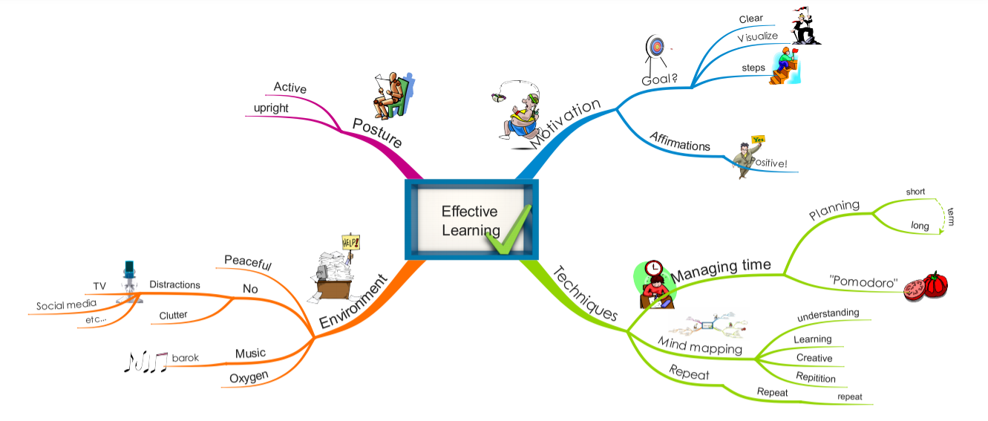
Practical mind map about study and learning habits.
Source: https://www.biggerplate.com/mindmaps/9epPfk00/effective-learning

Slide 13
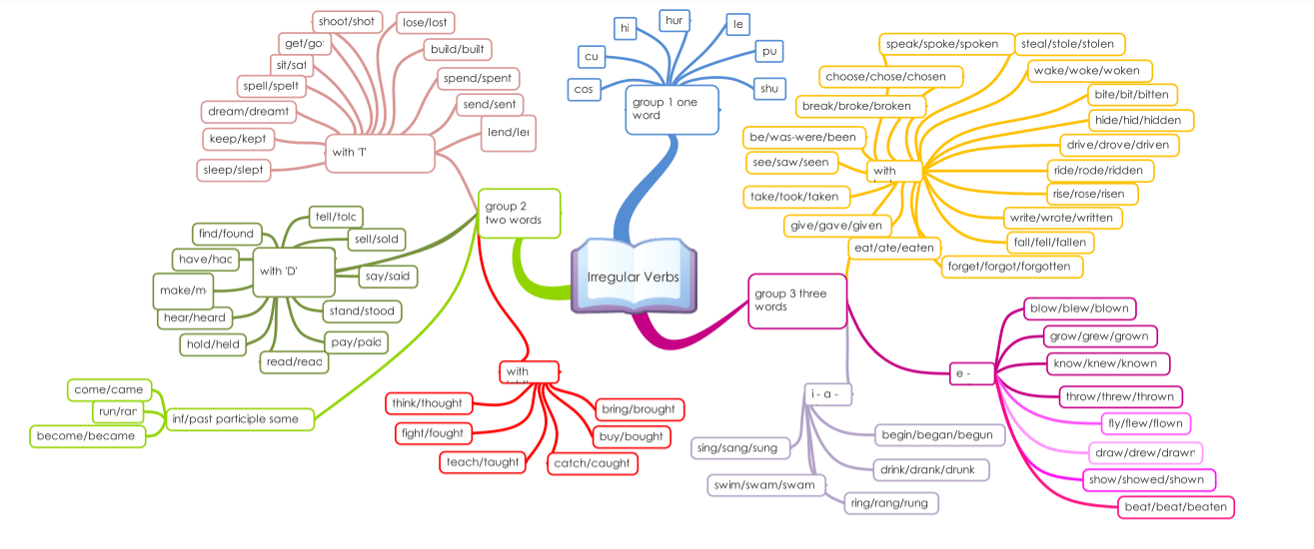
Source: https://www.biggerplate.com/mindmaps/ObuIGBhv/irregular-verbs-in-english

Slide 14
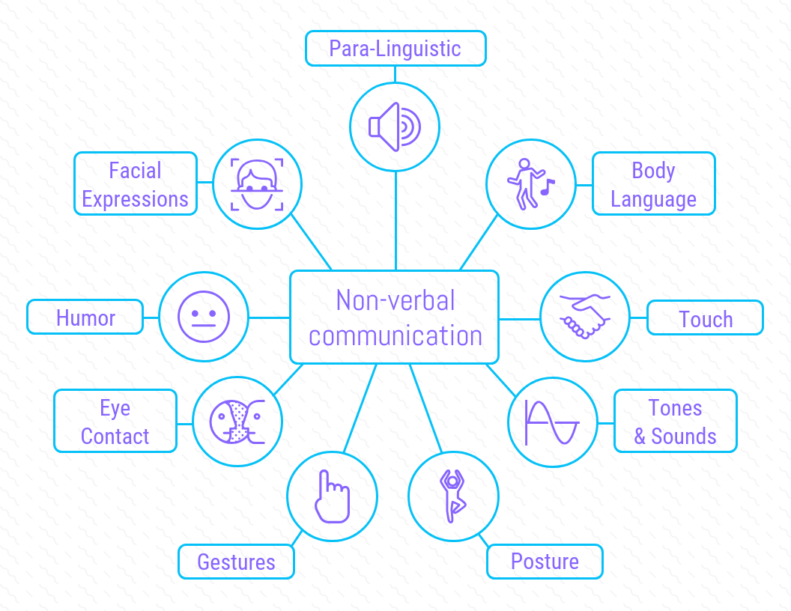
Source: https://ja.venngage.com/templates/mind-maps/corporate-communication-mind-map-5ac96049-3594-4a3f-9520-4f45866f2b4e
Notes:
Source: https://ja.venngage.com/templates/mind-maps/corporate-communication-mind-map-5ac96049-3594-4a3f-9520-4f45866f2b4e

Slide 15
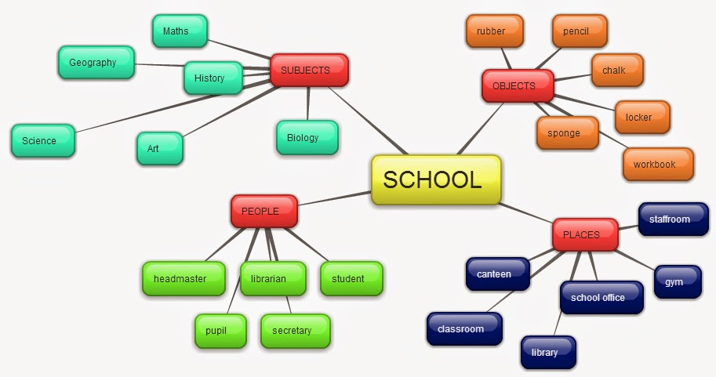
Source: http://ang1b.blogspot.com/p/zadanie-5-mapa-mysli.html

Slide 16
Applications to create mind maps
1.GitMind – https://gitmind.com/
2.Freeplane
3.Freemind
4.Coggle
5.Mindomo
6.Bubbl - www.bubbl.us
7.Canva
8.Miro
9. Popplet - POPPLET.COM
Source: https://sardynkibiznesu.pl/przydatne-programy-przedsiebiorcy/mapy-mysli-darmowe/

Slide 17
CREATE YOUR MIND MAP
SPORT
PEOPLE
TRAVEL AND TRANSPORT
FILMS
HISTORY
NATURAL ENVIRONMENT
WORK
HEALTH
Other topics: environment, biology, chemistry, physics, mathematics, art, music, etc.
Source: http://ang1b.blogspot.com/p/zadanie-5-mapa-mysli.html

Slide 18
WSBINOZ team:
Alina Doroch
Iwona Drzeniecka
Katarzyna Baeck – Kamińska
Tadeusz Mazurkiewicz
Teresa Mazurkiewicz
Joanna Komorek

