Slide 1



To know and Face Functional Illiteracy, Bulgaria, July 2021
Media (Il)Literacy
and How to Spot Fake News
Jerca Božič Kranjec, Novo mesto, Slovenia
Notes:
I‘m Jerca Božič Kranjec, journalist by profession, now a lecturer at the Higher Vocational College for Media Production. I could say that media literacy has become my passion, especially since in the last decade, when the flood of internet media and social networks has allowed previously unsuspected dimensions of deception and manipulation of users, recipients of media messages. There is a huge deficit of media literacy in our school system and also in adult education. To many, this seems an exaggerated claim, but I can attribute this to the fact that we do not know the difference between digital and media literacy.

Slide 2
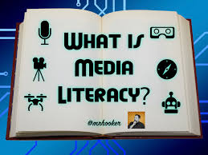
„Media literacy is the ability to access, analyze, evaluate, and produce / create (media) messages in a variety of forms.“ (Renne Hobbs)
Notes:
So let me emphasize there is a significant difference between digital literacy and media literacy. Digital literacy is about mastering the skills to use the media. Media literacy includes reading, writing, speaking, listening, critical watching, and the ability to form one’s own messages. Renne Hobbs, a professor and one of the leading authorities on teaching digital and media literacy, says: “Media literacy is the ability to access, analyze, evaluate, and produce / create (media) messages in a variety of forms (Hobbs, 1995). According to her, media education (as we can say media literacy) includes reading and writing, drawing and tickling, listening and speaking, critical viewing and selection of media content as skills of creating your own texts using various technologies, from billboards, cameras, microphones to video cameras (Hobbs 1995: 19). He also says that an important contribution of media literacy is understanding that information is socially constructed. Media literacy, according to Hobbes, must ask critical questions about what we see, read, and hear.

Slide 3

Process of media literacy
Behind-the-scenes of the media
Critical distance
Rational and active choice
To understand how the media shapes our perceptions of the world and ourselves
Notes:
Process of media lieracy reveals to us a behind-the-scenes look at the media, directs us to a critical distance from the media content offered and to a rational and active choice of media. It teaches us to understand how the media shapes our perceptions of the world and ourselves, which is the central concept of media literacy.

Slide 4
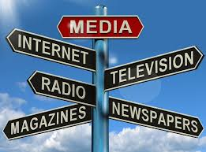
When are we media literate?
When we grow from purely selective recipients of media messages to participatory and critical creators.
Notes:
So when are we media literate? When we have or know how to use the possibilities of access to the media, when we are able to analyze and evaluate media messages, recognize manipulation and, last but not least, when we are able to create media messager in various forms. So when we grow from purely selective recipients of media messages to participatory and critical creators. A prerequisite for this is: a basic knowledge of the broad social, cultural, economic, political and historical context in which the media create.

Slide 5

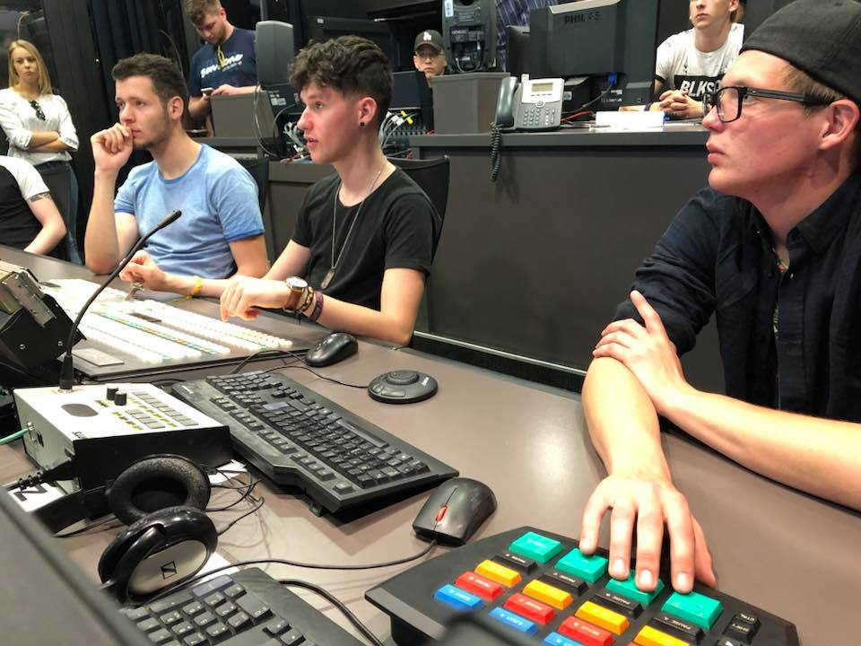
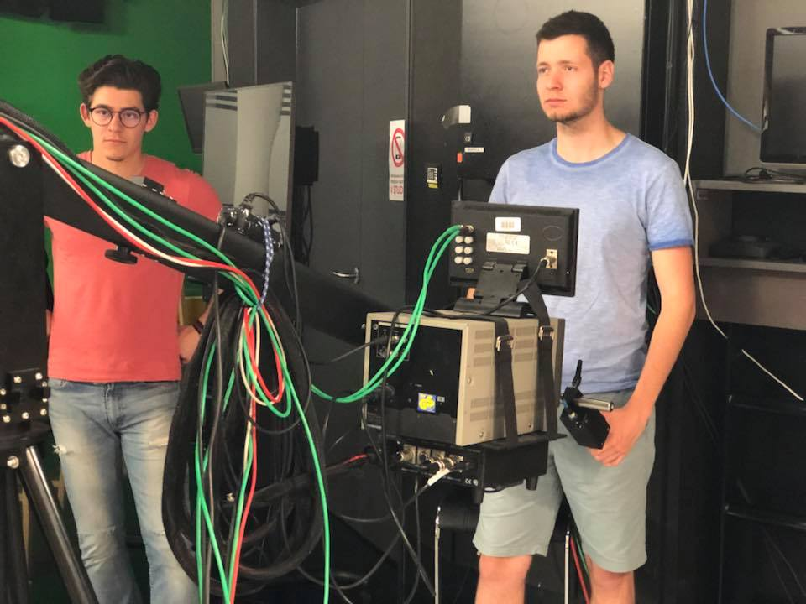
Notes:
Let me show you through a few short entertaining films made by our students how the process of media literacy takes place in our school through the creation of media products.

Slide 6
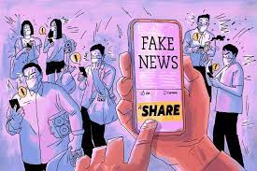
Notes:
And now to something that can question our media literacy. Fake news. It has happened to all of us. We browsed social networks and came across an article whose title shocked us. We clicked on it with all the interest. The expertly written article enriched his claims with "evidence", and here and there a famous professor or eyewitness is mentioned, who defends the content of the article. Then you soon found out what it was all about. It‘s “fake” news that has infected social media.

Slide 7
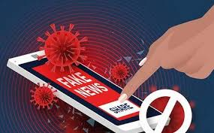
How is it that fake news goes so well?
Digital illiteracy
Media illiteracy
Notes:
How is ti that fake news goes so well? People click on the article, read a few sentences and immediately share the news or comment. By doing so, they help in the fire of fake news.

Slide 8
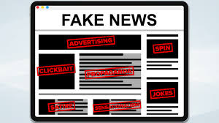
Why fake news?
To increase profits
To intimidate, spread panic or slander opponents
Out of boredom
For more traffic on the website
Notes:
Why fake news at all? Fake news can serve many purposes. They can be commissioned by entrepreneurs to help increase profits. They can also be used to intimidate, spread panic, or slander opponents. Political parties or individuals usually hide behind such purposes.Some people are just bored and make up the news and watch the flames of lies spread. Many times, however, these are media portals that would like more traffic and therefore more money that they get through advertising on their pages.

Slide 9
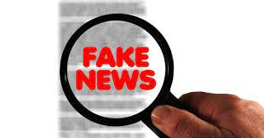
How to spot fake news?
Notes:
There are some short recommendations that can help us when we are in doubt about whether the news is fake or not. Let's take a look at them.

Slide 10
Consider the source
Click away from the story to investigate the site, its mission and its contact info.

Slide 11
Read beyond the headline
Headlines can be outrageous in an effort to get clicks. What‘s the whole story about?
Do not infer content only by title.

Slide 12
Check the author
Do a quick research on the author. Is he credible? Is he real?
Notes:
Enter the author's name in the browser. See how many hits he shows you. Did this person write any other article? For what portal, magazine, newspaper? Is it real at all?

Slide 13
What‘s the support?
Click on those links. Determine if the info given actually supports the story.

Slide 14
Check the date
Reposting old news stories doesn‘t mean they‘re relevant to current events.

Slide 15
Is this some kind of joke?
If it is too outlandish, it might be a satire. Research the site and the author to be sure.

Slide 16
Check your biases
Consider if your own beliefs could affect your judgement.

Slide 17
Consult the experts
Ask the experts, or consult the fact-checking site (FactCheck.org, Snopes.com, PolitiFact.com...).

Slide 18
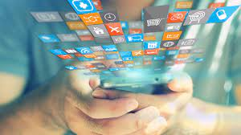
Thank you for your attention

